Slide 1
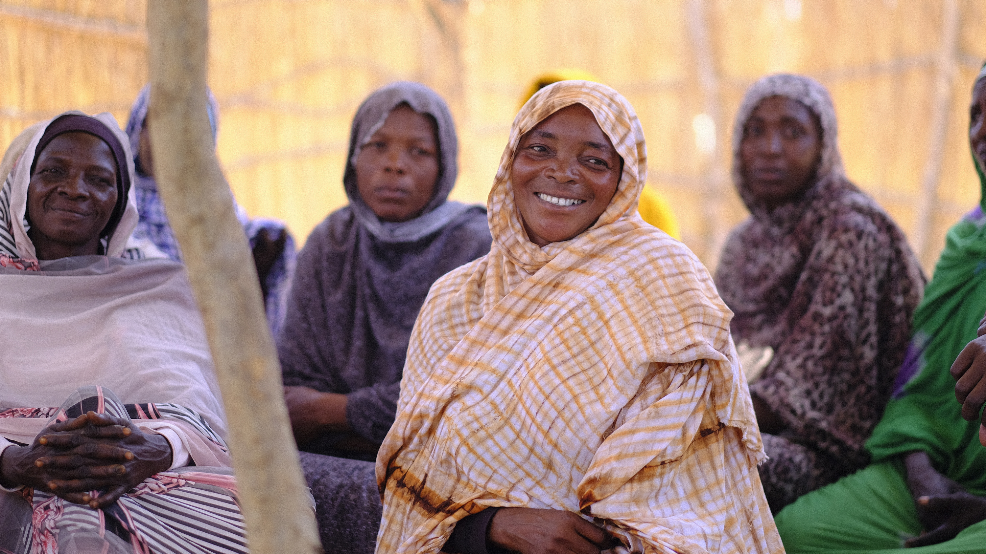
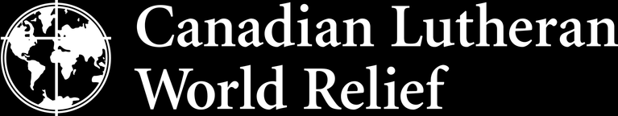
"You shall also love the stranger, for you were strangers in the land of Egypt."
— Deuteronomy 10:19 (NRSV)
On World Refugee Day, we take a moment to pause and honour the strength and courage of people who have been forced to flee their homes. As more then 117 million people are displaced around the world, we stand in solidarity with refugees as we pray for their safety and for those who will offer welcome.

