Slide 1
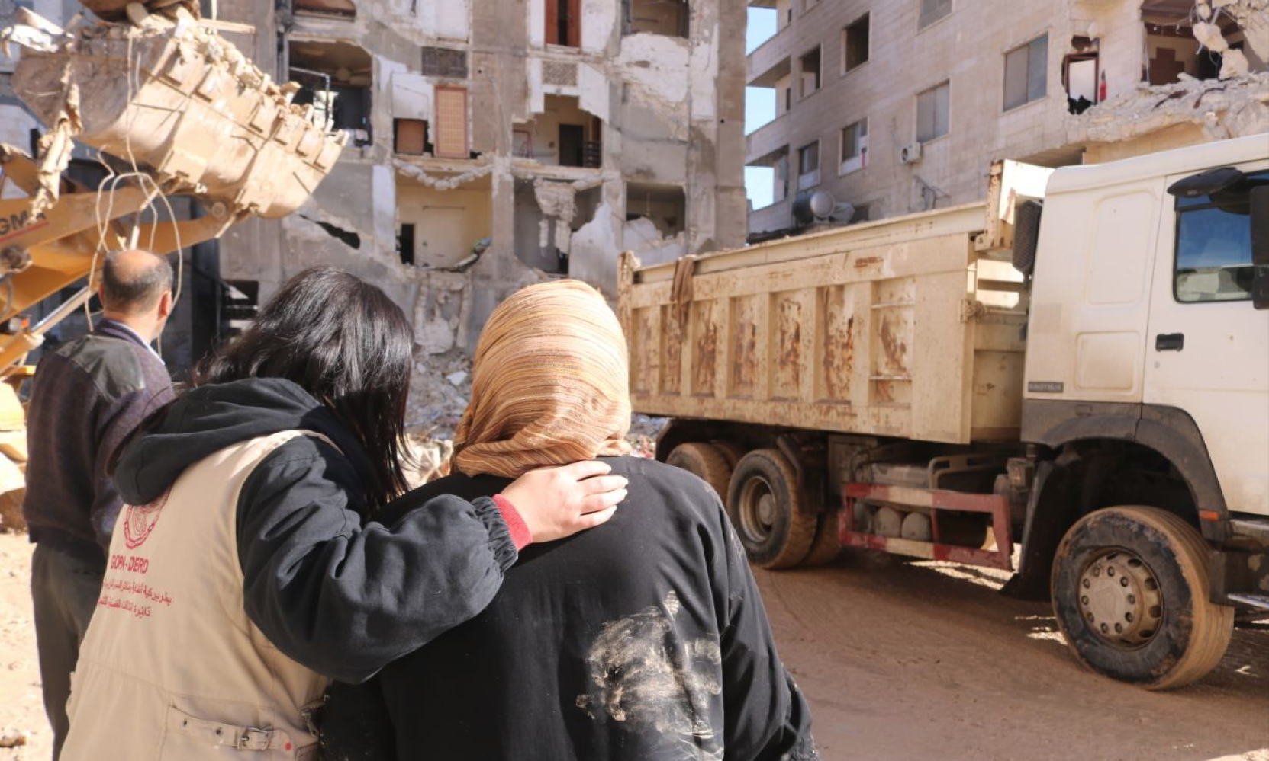
Thank you!
Your support of CLWR's response to the earthquakes in Türkiye and Syria has enabled our partners to help those in need of immediate assistance.
Please continue to join us in praying for all those affected by this crisis.
For updates and to find out how you can help, please visit clwr.org/earthquake-response

