Slide 1

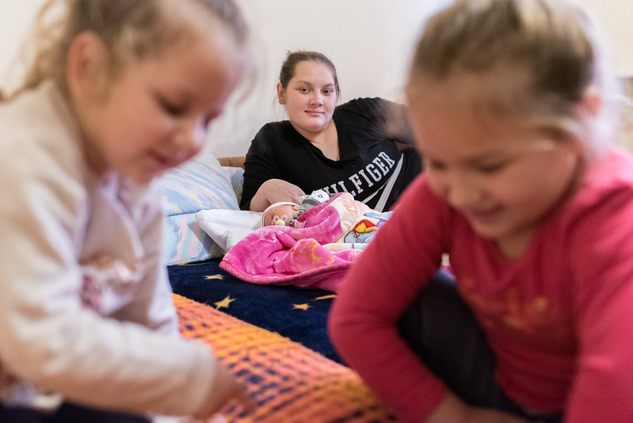
Ukrainian refugee Paulina, pictured here at a temporary shelter in Hungary with her newborn and two older daughters. The family was forced to flee Ukraine while Paulina was 8-months pregnant, and she gave birth as soon as they crossed the border into Hungary. (Photo credit: LWF/Albin Hillert)
CLWR partners in the ACT Alliance and LWF have provided the following support to the 7 million refugees who have fled Ukraine and the 8 million people who are internally displaced:
Delivery of 676 tons of food and non-food items
Delivery of $9.8 million worth of medical equipment
Establishment of 2 Refugee Support Points – in Barabás, Hungary and Asztely, Ukraine – to provide links to safe transport and food for refugees.
Establishment of 2 Child Friendly Spaces in Budapest as hubs for displaced families to access information and basic necessities.
Establishment of transitional shelters in Hungary and Ukraine.
Much more is needed. Donate online at clwr.org/Ukraine or call 1-800-661-2597 (Mon-Fri 8:30am-4:00pm CST).
UKRAINE CRISIS RESPONSE | JUNE 09, 2022

